Slide 1
Data Mining: Concepts and Techniques (3rd ed.) — Chapter 6 —
Jiawei Han, Micheline Kamber, and Jian Pei
University of Illinois at Urbana-Champaign &
Simon Fraser University
©2011 Han, Kamber & Pei. All rights reserved.
1
Notes:
1

Slide 2
Chapter 5: Mining Frequent Patterns, Association and Correlations: Basic Concepts and Methods
Basic Concepts
Frequent Itemset Mining Methods
Which Patterns Are Interesting?—Pattern Evaluation Methods
Summary

Slide 3
What Is Frequent Pattern Analysis?
Frequent pattern: a pattern (a set of items, subsequences, substructures, etc.) that occurs frequently in a data set
First proposed by Agrawal, Imielinski, and Swami [AIS93] in the context of frequent itemsets and association rule mining
Motivation: Finding inherent regularities in data
What products were often purchased together?— Beer and diapers?!
What are the subsequent purchases after buying a PC?
What kinds of DNA are sensitive to this new drug?
Can we automatically classify web documents?
Applications
Basket data analysis, cross-marketing, catalog design, sale campaign analysis, Web log (click stream) analysis, and DNA sequence analysis.

Slide 4
Why Is Freq. Pattern Mining Important?
Freq. pattern: An intrinsic and important property of datasets
Foundation for many essential data mining tasks
Association, correlation
Sequential, structural (e.g., sub-graph) patterns
Pattern analysis in spatiotemporal, multimedia, time-series, and stream data
Classification: discriminative, frequent pattern analysis
Cluster analysis: frequent pattern-based clustering

Slide 5
Basic Concepts: Frequent Patterns
Tid | Items bought
10 | Beer, Nuts, Diaper
20 | Beer, Coffee, Diaper
30 | Beer, Diaper, Eggs
40 | Nuts, Eggs, Milk
50 | Nuts, Coffee, Diaper, Eggs, Milk
itemset: A set of one or more items
k-itemset X = {x₁, …, x_{k}}
(absolute) support, or, support count of X: Frequency or occurrence of an itemset X
(relative) support, s, is the fraction of transactions that contains X (i.e., the probability that a transaction contains X)
An itemset X is frequent if X’s support is no less than a minsup threshold
Customer
buys both
Customer
buys diaper
Customer
buys beer

Slide 6
Basic Concepts: Association Rules
Tid
Items bought
Find all the rules X → Y with minimum support and confidence
support, s, probability that a transaction contains X ∪ Y
confidence, c, conditional probability that a transaction having X also contains Y
Let minsup = 50%, minconf = 50%
Freq. Pat.: Beer:3, Nuts:3, Diaper:4, Eggs:3, {Beer, Diaper}:3
10
Beer, Nuts, Diaper
20
Beer, Coffee, Diaper
30
Beer, Diaper, Eggs
40
Nuts, Eggs, Milk
50
Nuts, Coffee, Diaper, Eggs, Milk
Customer
buys both
Customer
buys diaper
Customer
buys beer
Association rules: (many more!)
Beer → Diaper (60%, 100%)
Diaper → Beer (60%, 75%)

Slide 7
Association Rules Measurement
The most commonly used “interestingness” measures are:
Support
Confidence

Slide 8
Itemset Support
Support: A measure of the frequency with which an itemset occurs in a DB.
If an itemset has support higher than some specified threshold we say that the itemset is supported or frequent (some authors use the term large).
Support threshold is normally set reasonably low (say) 1%.
supp(A) = # records that contain A
m

Slide 9
Confidence
Confidence: A measure, expressed as a ratio, of the support for an AR compared to the support of its antecedent.
We say that we are confident in a rule if its confidence exceeds some threshold (normally set reasonably high, say, 80%).
conf(A→B) = supp(A∪B)
supp(A)

Slide 10
Association Rule Mining
In general, association rule mining can be viewed as a two-step process:
1. Find all frequent itemsets: By definition, each of these itemsets will occur at least as frequently as a predetermined minimum support count, min sup.
2. Generate strong association rules from the frequent itemsets: By definition, these rules must satisfy minimum support and minimum confidence.

Slide 11
Mining Association Rules
Example of Rules:
{Milk,Diaper} → {Beer} (s=0.4, c=0.67) {Milk,Beer} → {Diaper} (s=0.4, c=1.0)
{Diaper,Beer} → {Milk} (s=0.4, c=0.67)
{Beer} → {Milk,Diaper} (s=0.4, c=0.67) {Diaper} → {Milk,Beer} (s=0.4, c=0.5)
{Milk} → {Diaper,Beer} (s=0.4, c=0.5)
Observations:
All the above rules are binary partitions of the same itemset: {Milk, Diaper, Beer}
Rules originating from the same itemset have identical support but can have different confidence
Thus, we may decouple the support and confidence requirements

Slide 12
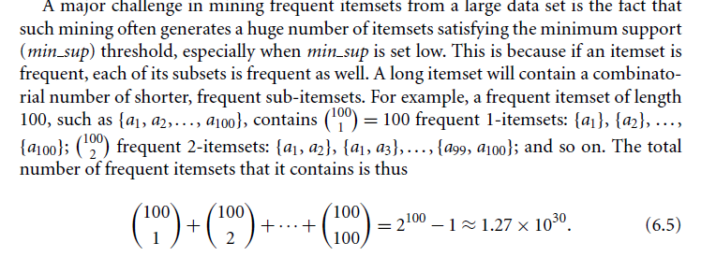
Computational Complexity of Frequent Itemset Mining

Slide 13
Scalable Frequent Itemset Mining Methods
Apriori: A Candidate Generation-and-Test Approach
Improving the Efficiency of Apriori
FPGrowth: A Frequent Pattern-Growth Approach
ECLAT: Frequent Pattern Mining with Vertical Data Format

Slide 14
Apriori Property
All nonempty subsets of a frequent itemset must also be frequent.
The Apriori property is based on the following observation. By definition, if an itemset I does not satisfy the minimum support threshold, min sup, then I is not frequent, that is, P.I/ < min sup.
If an item A is added to the itemset I, then the resulting itemset cannot occur more frequently than I. Therefore, I [A is not frequent either, that is, P(I U A)/< min sup.

Slide 15
Apriori: A Candidate Generation & Test Approach
Apriori pruning principle: If there is any itemset which is infrequent, its superset should not be generated/tested! (Agrawal & Srikant @VLDB’94, Mannila, et al. @ KDD’ 94)
Method:
Initially, scan DB once to get frequent 1-itemset
Generate length (k+1) candidate itemsets from length k frequent itemsets
Test the candidates against DB
Terminate when no frequent or candidate set can be generated

Slide 16
The Apriori Algorithm—An Example
Sup_{min} = 2
Itemset | sup
{A} | 2
{B} | 3
{C} | 3
{D} | 1
{E} | 3
Database TDB
Itemset | sup
{A} | 2
{B} | 3
{C} | 3
{E} | 3
L₁
Tid | Items
10 | A, C, D
20 | B, C, E
30 | A, B, C, E
40 | B, E
C₁
1st scan
C₂
Itemset | sup
{A, B} | 1
{A, C} | 2
{A, E} | 1
{B, C} | 2
{B, E} | 3
{C, E} | 2
C₂
Itemset
{A, B}
{A, C}
{A, E}
{B, C}
{B, E}
{C, E}
L₂
Itemset | sup
{A, C} | 2
{B, C} | 2
{B, E} | 3
{C, E} | 2
2nd scan
C₃
Itemset
{B, C, E}
3rd scan
L₃
Itemset | sup
{B, C, E} | 2

Slide 17
The Apriori Algorithm (Pseudo-Code)
C_{k}: Candidate itemset of size k
L_{k} : frequent itemset of size k
L₁ = {frequent items};
for (k = 1; L_{k} !=∅; k++) do begin
C_{k+1} = candidates generated from L_{k};
for each transaction t in database do
increment the count of all candidates in C_{k+1} that are contained in t
L_{k+1} = candidates in C_{k+1} with min_support
end
return ∪_{k} L_{k};

Slide 18
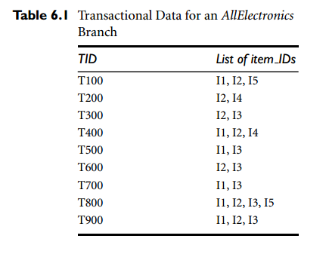
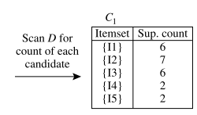
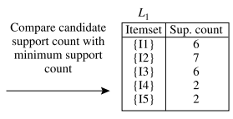

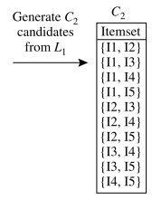
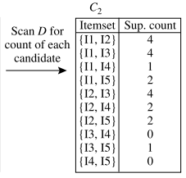
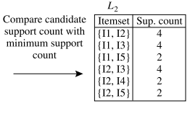
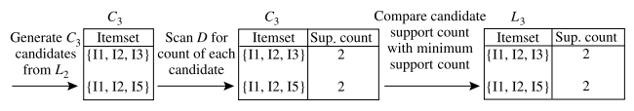

Slide 19
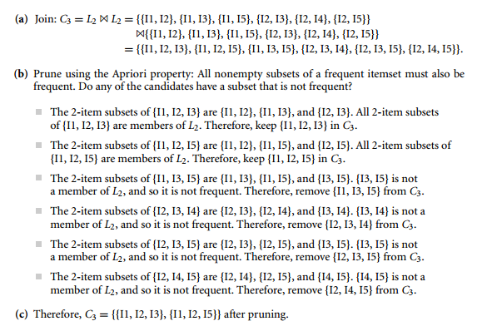
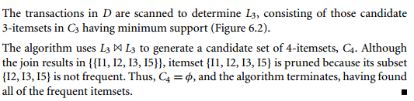

Slide 20
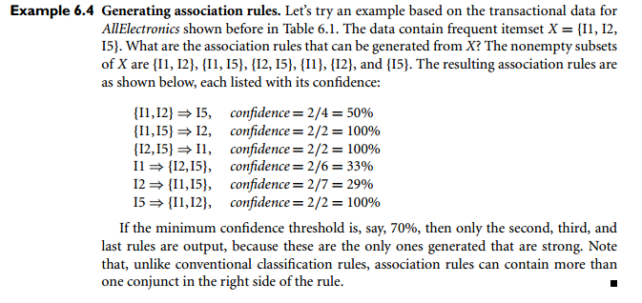
Generating Association Rules Example

Slide 21
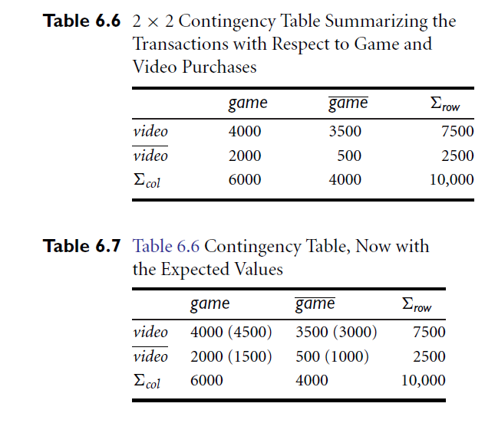

Slide 22
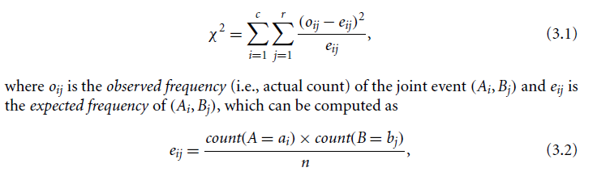

Slide 23
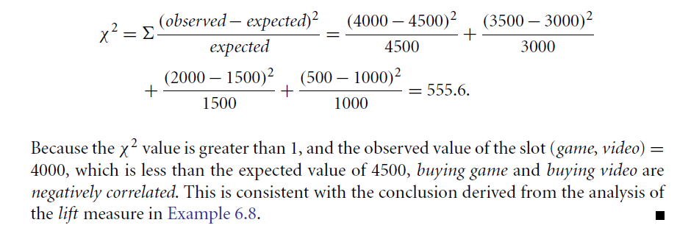
Example 6.9

Slide 24
Interestingness Measure: Correlations (Lift)
play basketball ⇒ eat cereal [40%, 66.7%] is misleading
The overall % of students eating cereal is 75% > 66.7%.
play basketball ⇒ not eat cereal [20%, 33.3%] is more accurate, although with lower support and confidence
Measure of dependent/correlated events: lift
Less than 1 negative correlation Greater than 1 positive correlation
 | Basketball | Not basketball | Sum (row)
Cereal | 2000 | 1750 | 3750
Not cereal | 1000 | 250 | 1250
Sum(col.) | 3000 | 2000 | 5000

Slide 25
Computing Interestingness Measure
Given a rule X → Y, information needed to compute rule interestingness can be obtained from a contingency table
Contingency table for X → Y
 | Y | Y
X | f₁₁ | f₁₀ | f₁₊
X | f₀₁ | f₀₀ | f_{o+}
 | f₊₁ | f₊₀ | |T|
f₁₁: support of X and Y f₁₀: support of X and Y f₀₁: support of X and Y f₀₀: support of X and Y
Used to define various measures
support, confidence, lift, Gini, J-measure, etc.

Slide 26
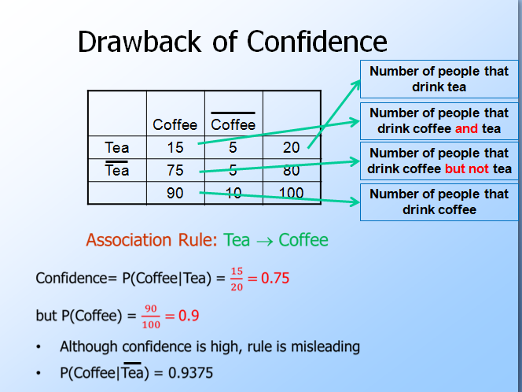

Slide 27
Scalable Frequent Itemset Mining Methods
27
Apriori: A Candidate Generation-and-Test Approach
Improving the Efficiency of Apriori
FPGrowth: A Frequent Pattern-Growth Approach
ECLAT: Frequent Pattern Mining with Vertical Data Format
Mining Close Frequent Patterns and Maxpatterns
Notes:
27

Slide 28
Pattern-Growth Approach: Mining Frequent Patterns Without Candidate Generation
FP-growth, which adopts a divide-and-conquer strategy as follows. First, it compresses the database representing frequent items into a frequent pattern tree, or FP-tree, which retains the itemset association information.
It then divides the compressed database into a set of conditional databases (a special kind of projected database), each associated with one frequent item or “pattern fragment,” and mines each database separately
For each “pattern fragment,” only its associated data sets need to be examined. Therefore, this approach may substantially reduce the size of the data sets to be searched, along with the “growth” of patterns being examined

Slide 29

Pattern-Growth Approach: Mining Frequent Patterns Without Candidate Generation
The first scan of the database is the same as Apriori, which derives the set of frequent items (1-itemsets) and their support counts (frequencies).
Let the minimum support count be 2. The set of frequent items is sorted in the order of descending support count.
This resulting set or list is denoted by L. For Table 6.1

Slide 30
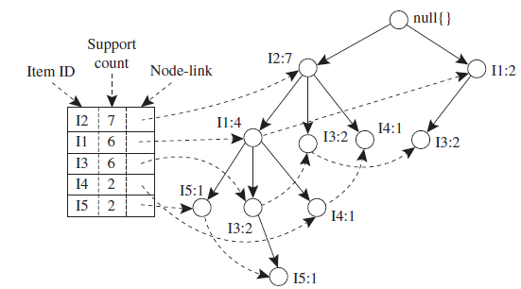
Constructing an FP Tree
First, create the root of the tree, labeled with “null.” Scan database D a second time. The items in each transaction are processed in L order (i.e descending support count), and a branch is created for each transaction.

Slide 31
Mining an FP Tree
Start from each frequent length-1 pattern (as an initial suffix pattern), construct its conditional pattern base (a “sub-database,” which consists of the set of prefix paths in the FP-tree co-occurring with the suffix pattern),
then construct its (conditional) FP-tree, and perform mining recursively on the tree. The pattern growth is achieved by the concatenation of the suffix pattern with the frequent patterns generated from a conditional FP-tree.

Slide 32
Mining an FP Tree
Start from each frequent length-1 pattern (as an initial suffix pattern), construct its conditional pattern base (a “sub-database,” which consists of the set of prefix paths in the FP-tree co-occurring with the suffix pattern),
then construct its (conditional) FP-tree, and perform mining recursively on the tree. The pattern growth is achieved by the concatenation of the suffix pattern with the frequent patterns generated from a conditional FP-tree.

Slide 33
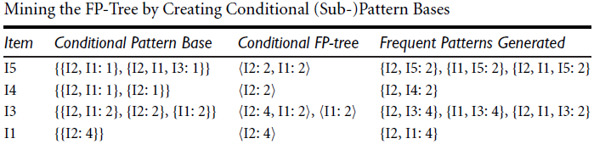
Mining an FP Tree
Mining

Slide 34
Benefits of the FP-tree Structure
The FP-growth method transforms the problem of finding long frequent patterns into searching for shorter ones in much smaller conditional databases recursively and then concatenating the suffix. It uses the least frequent items as a suffix, offering good selectivity. The method substantially reduces the search costs.
When the database is large, it is sometimes unrealistic to construct a main memory based FP-tree. An interesting alternative is to first partition the database into a set of projected databases, and then construct an FP-tree and mine it in each projected database. This process can be recursively applied to any projected database if its FP-tree still cannot fit in main memory.

